Slide 1

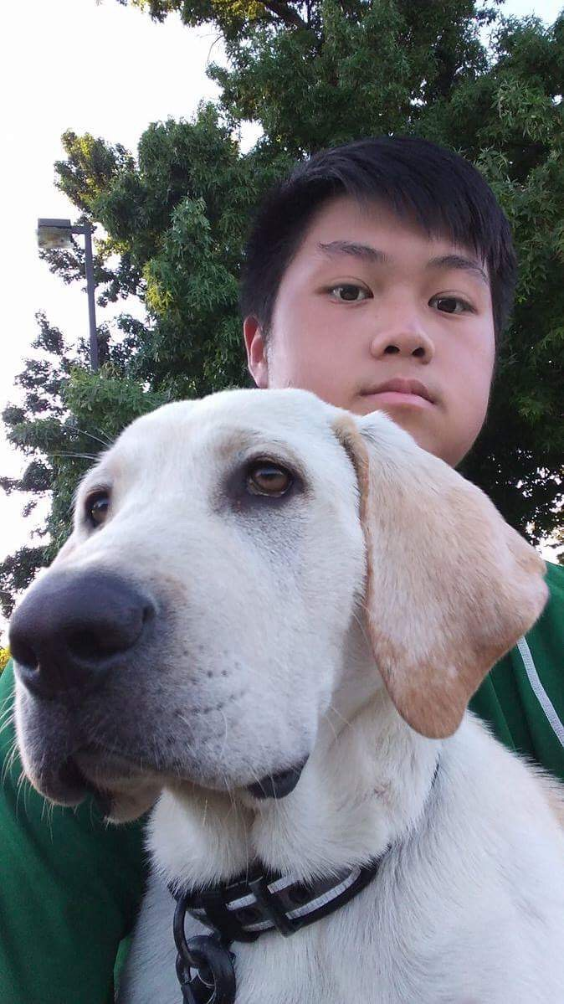
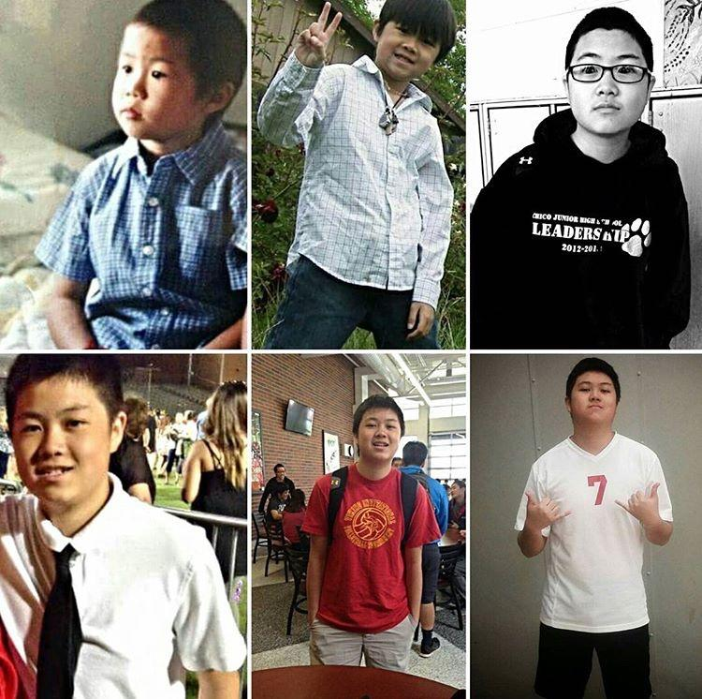
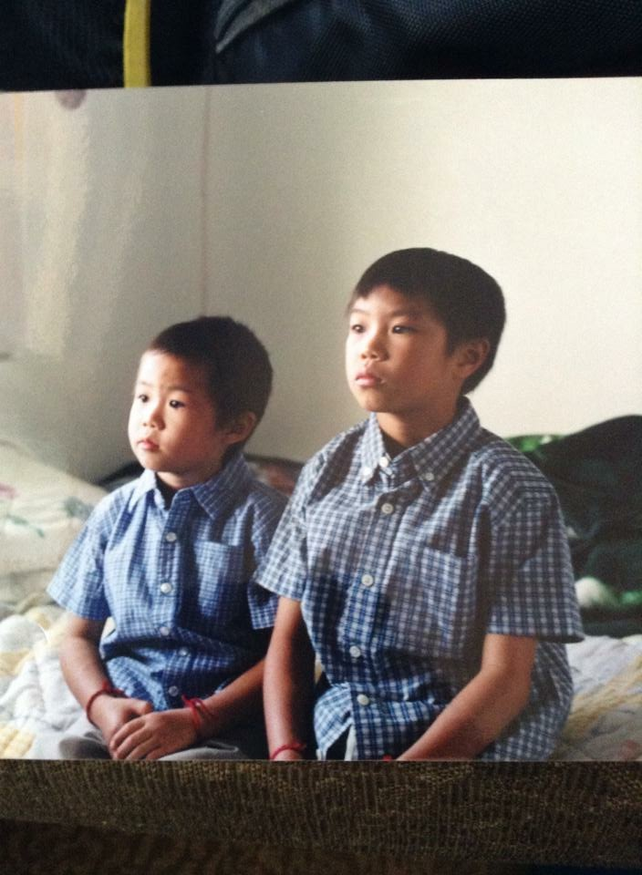
Manting Xiong
All About Me

Slide 2

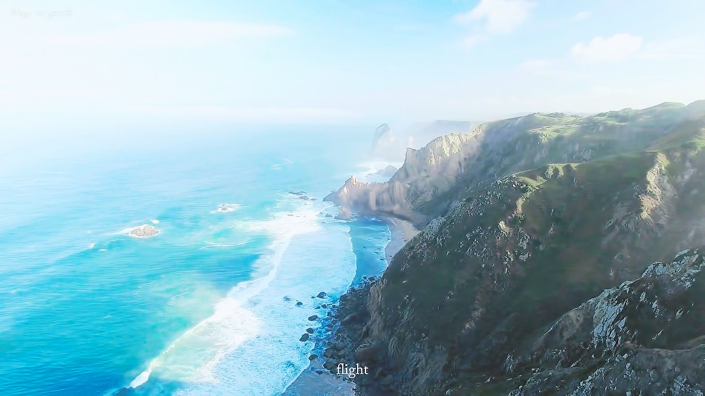
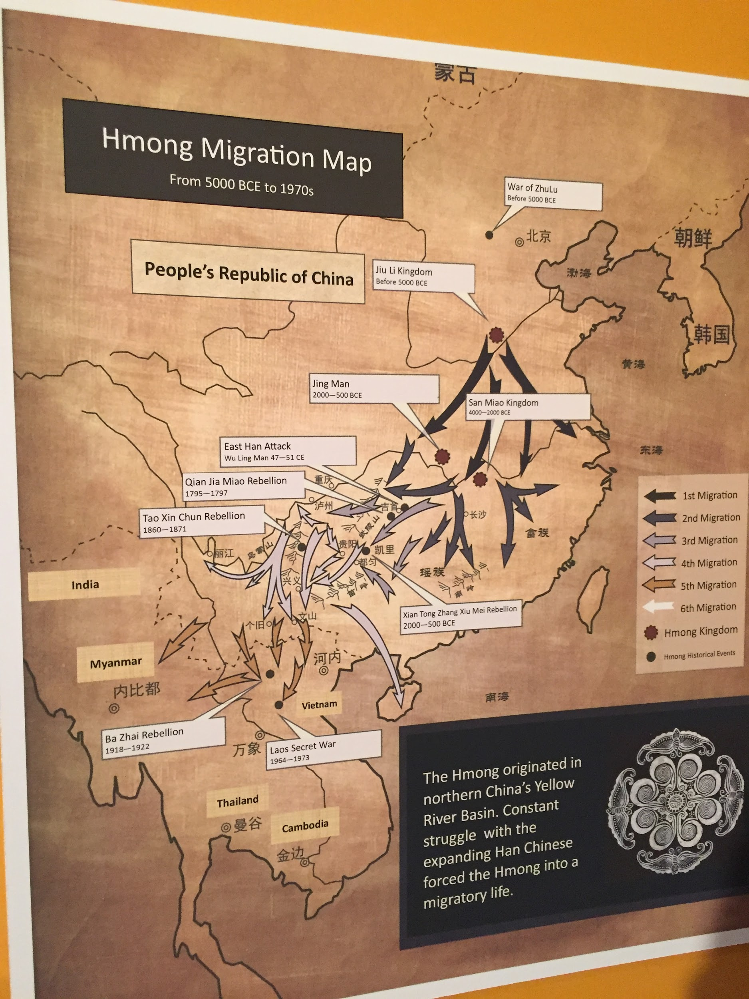
Origins
Born in Concord, NC, raised in Chico, CA
Parents divorced when I was 6 months old
First time meeting my mother in freshman year of high school
My family includes my older brother, father, grandmother, and I
Many cousins

Slide 3






My Educational Journey

Slide 4
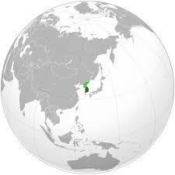
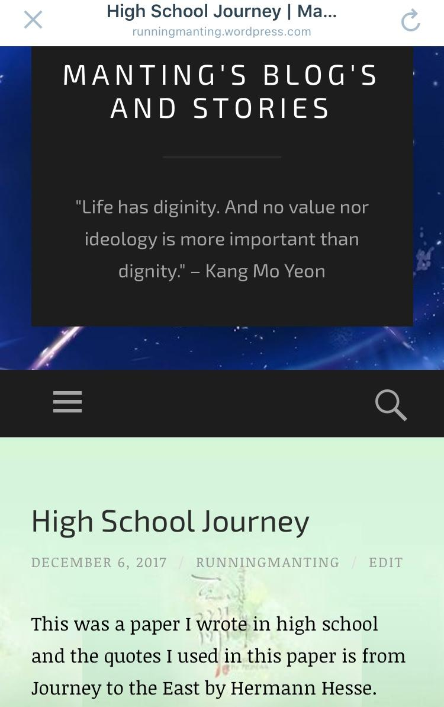
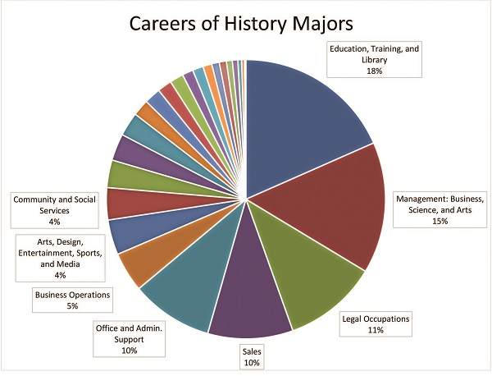
History Major (Pre - Credential)
Asian Studies Major (Not Yet Declared)
Creative Writing Minor (Not Yet Declared)
www.runningmanting.wordpress.com

Slide 5
Experience And Try New Things!
What I Did
High School
Mixed Chorus (1 Yr)
Acapella Choir (3 Yrs)
Sac Street Boys (1 Yr)
JV Volleyball (2 Yrs)
Varsity Volleyball (2 Yrs)
Student Government (1 Yr)
Asian Youth Awareness Club (3 Yrs)
ETS Student (6 Yrs)
Piano (1 Yr)
Computer Programming (1 Yr)
College
Hmong Student Association (1 Yr)
Momentum Dance Club (1 Semester)
Asian Pacific Islander in Higher Education (APAHE)
Summer Connection (1 Summer)
EOP Student (1 Yr)
Hmong Story Telling Workshops ( 1 Semester)
Jr. High
Leadership (1 Yr)

Slide 6
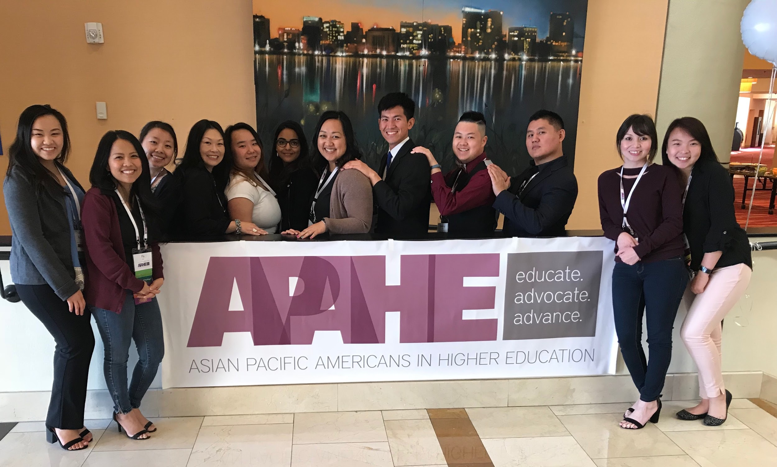
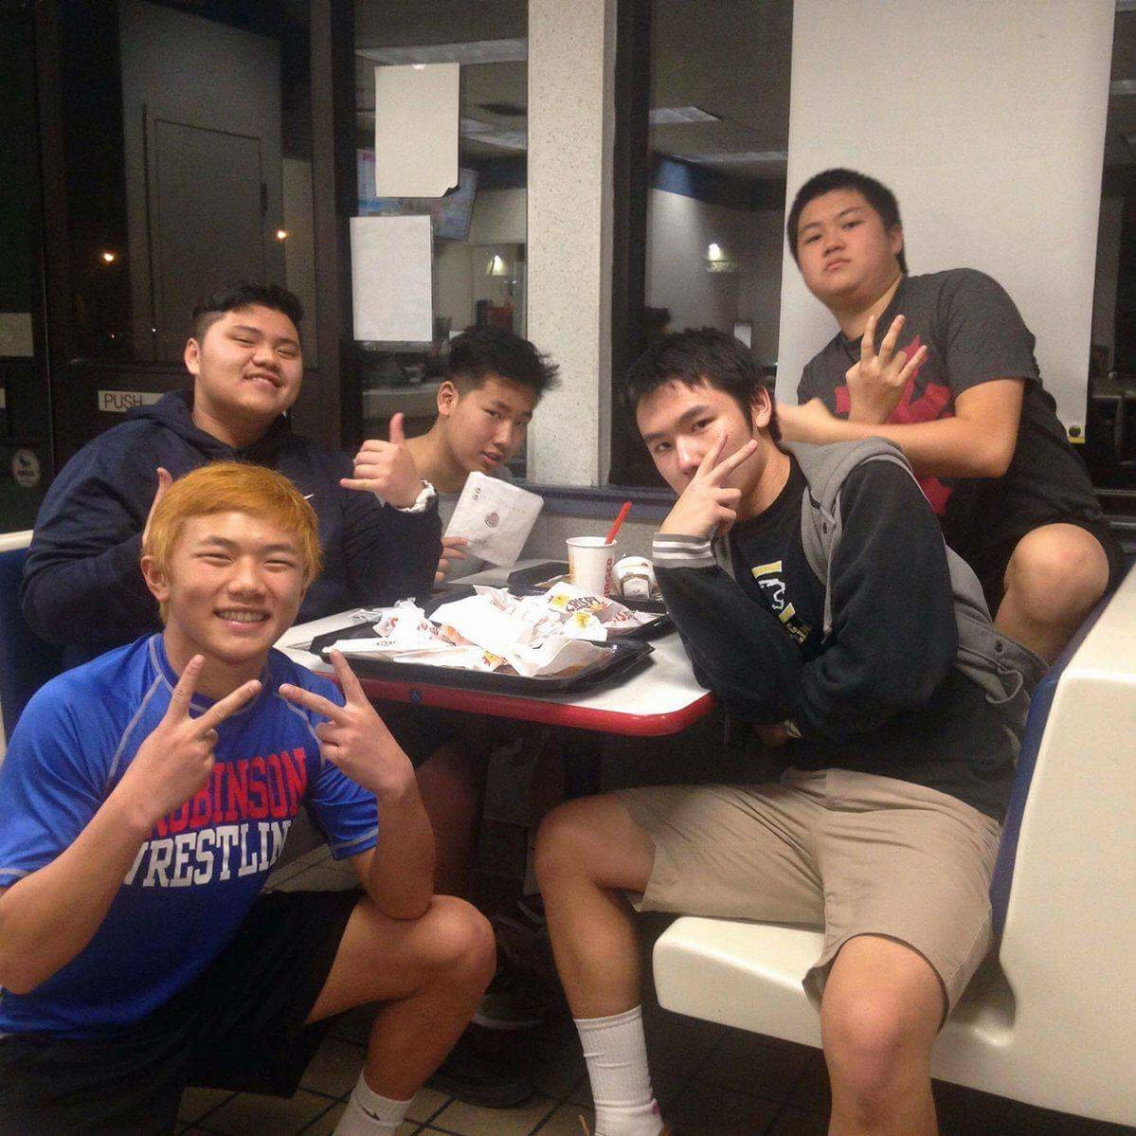
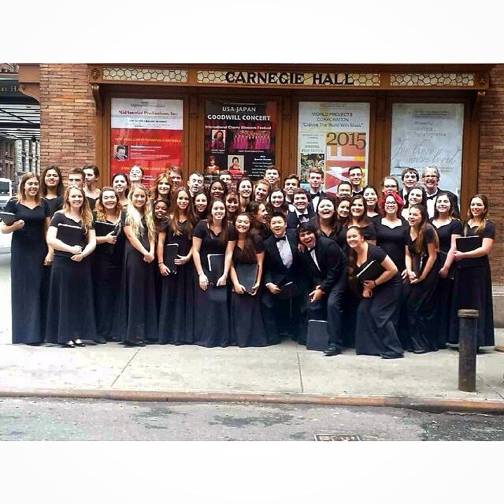
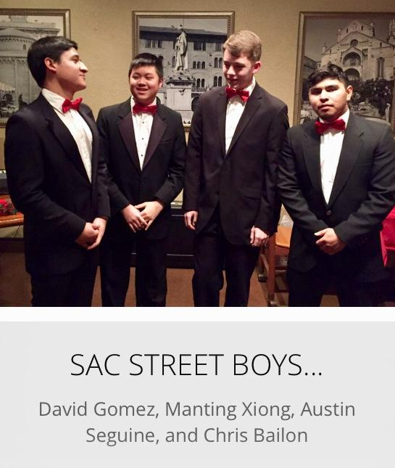
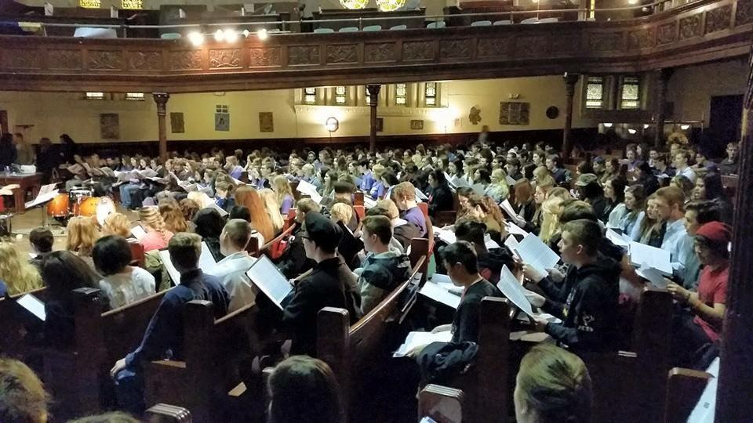
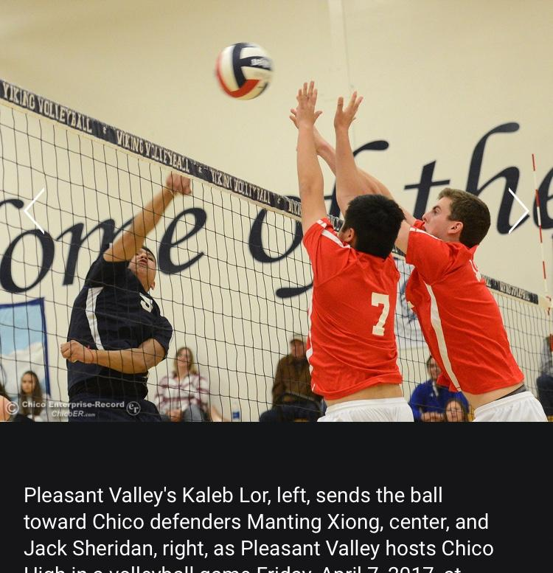
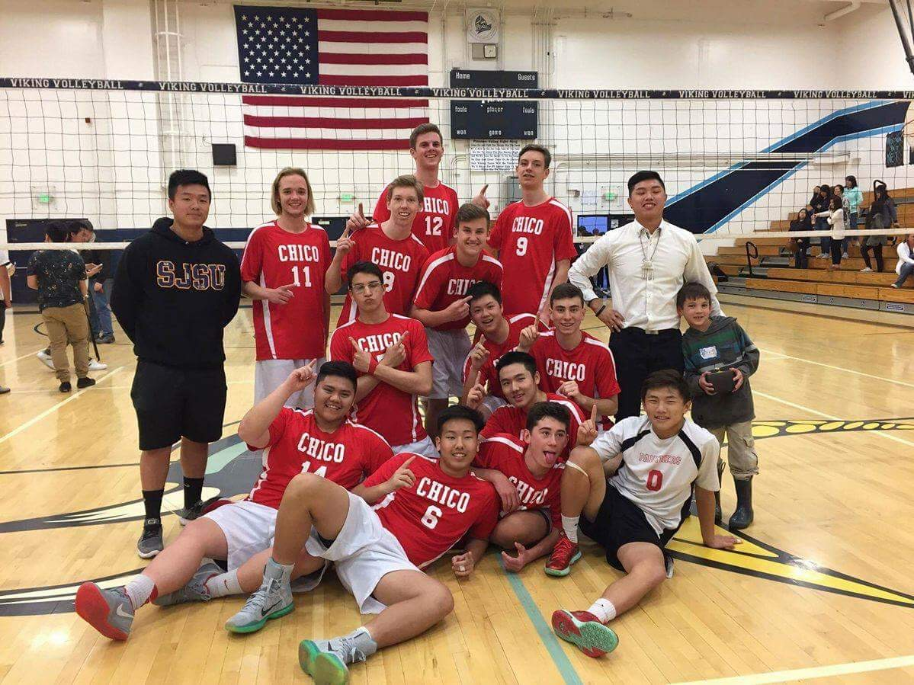
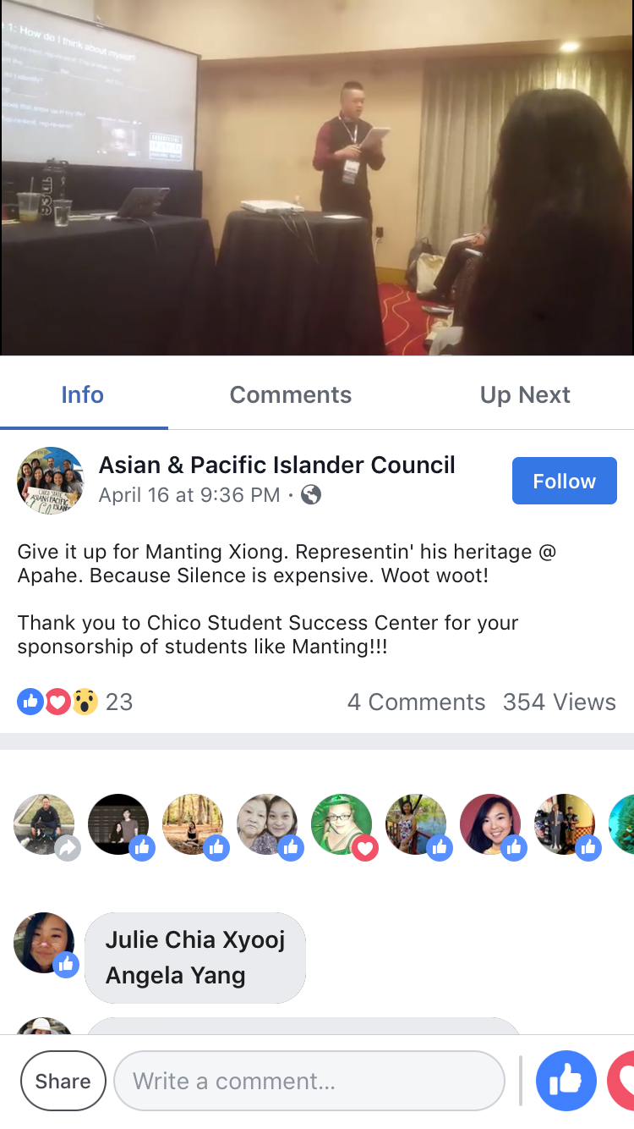
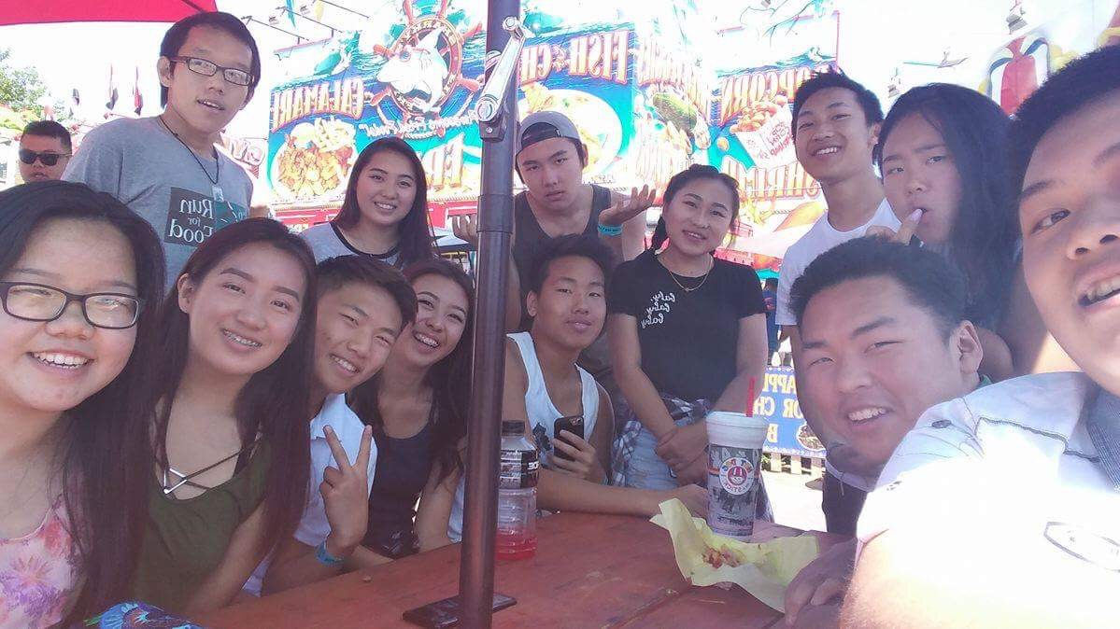
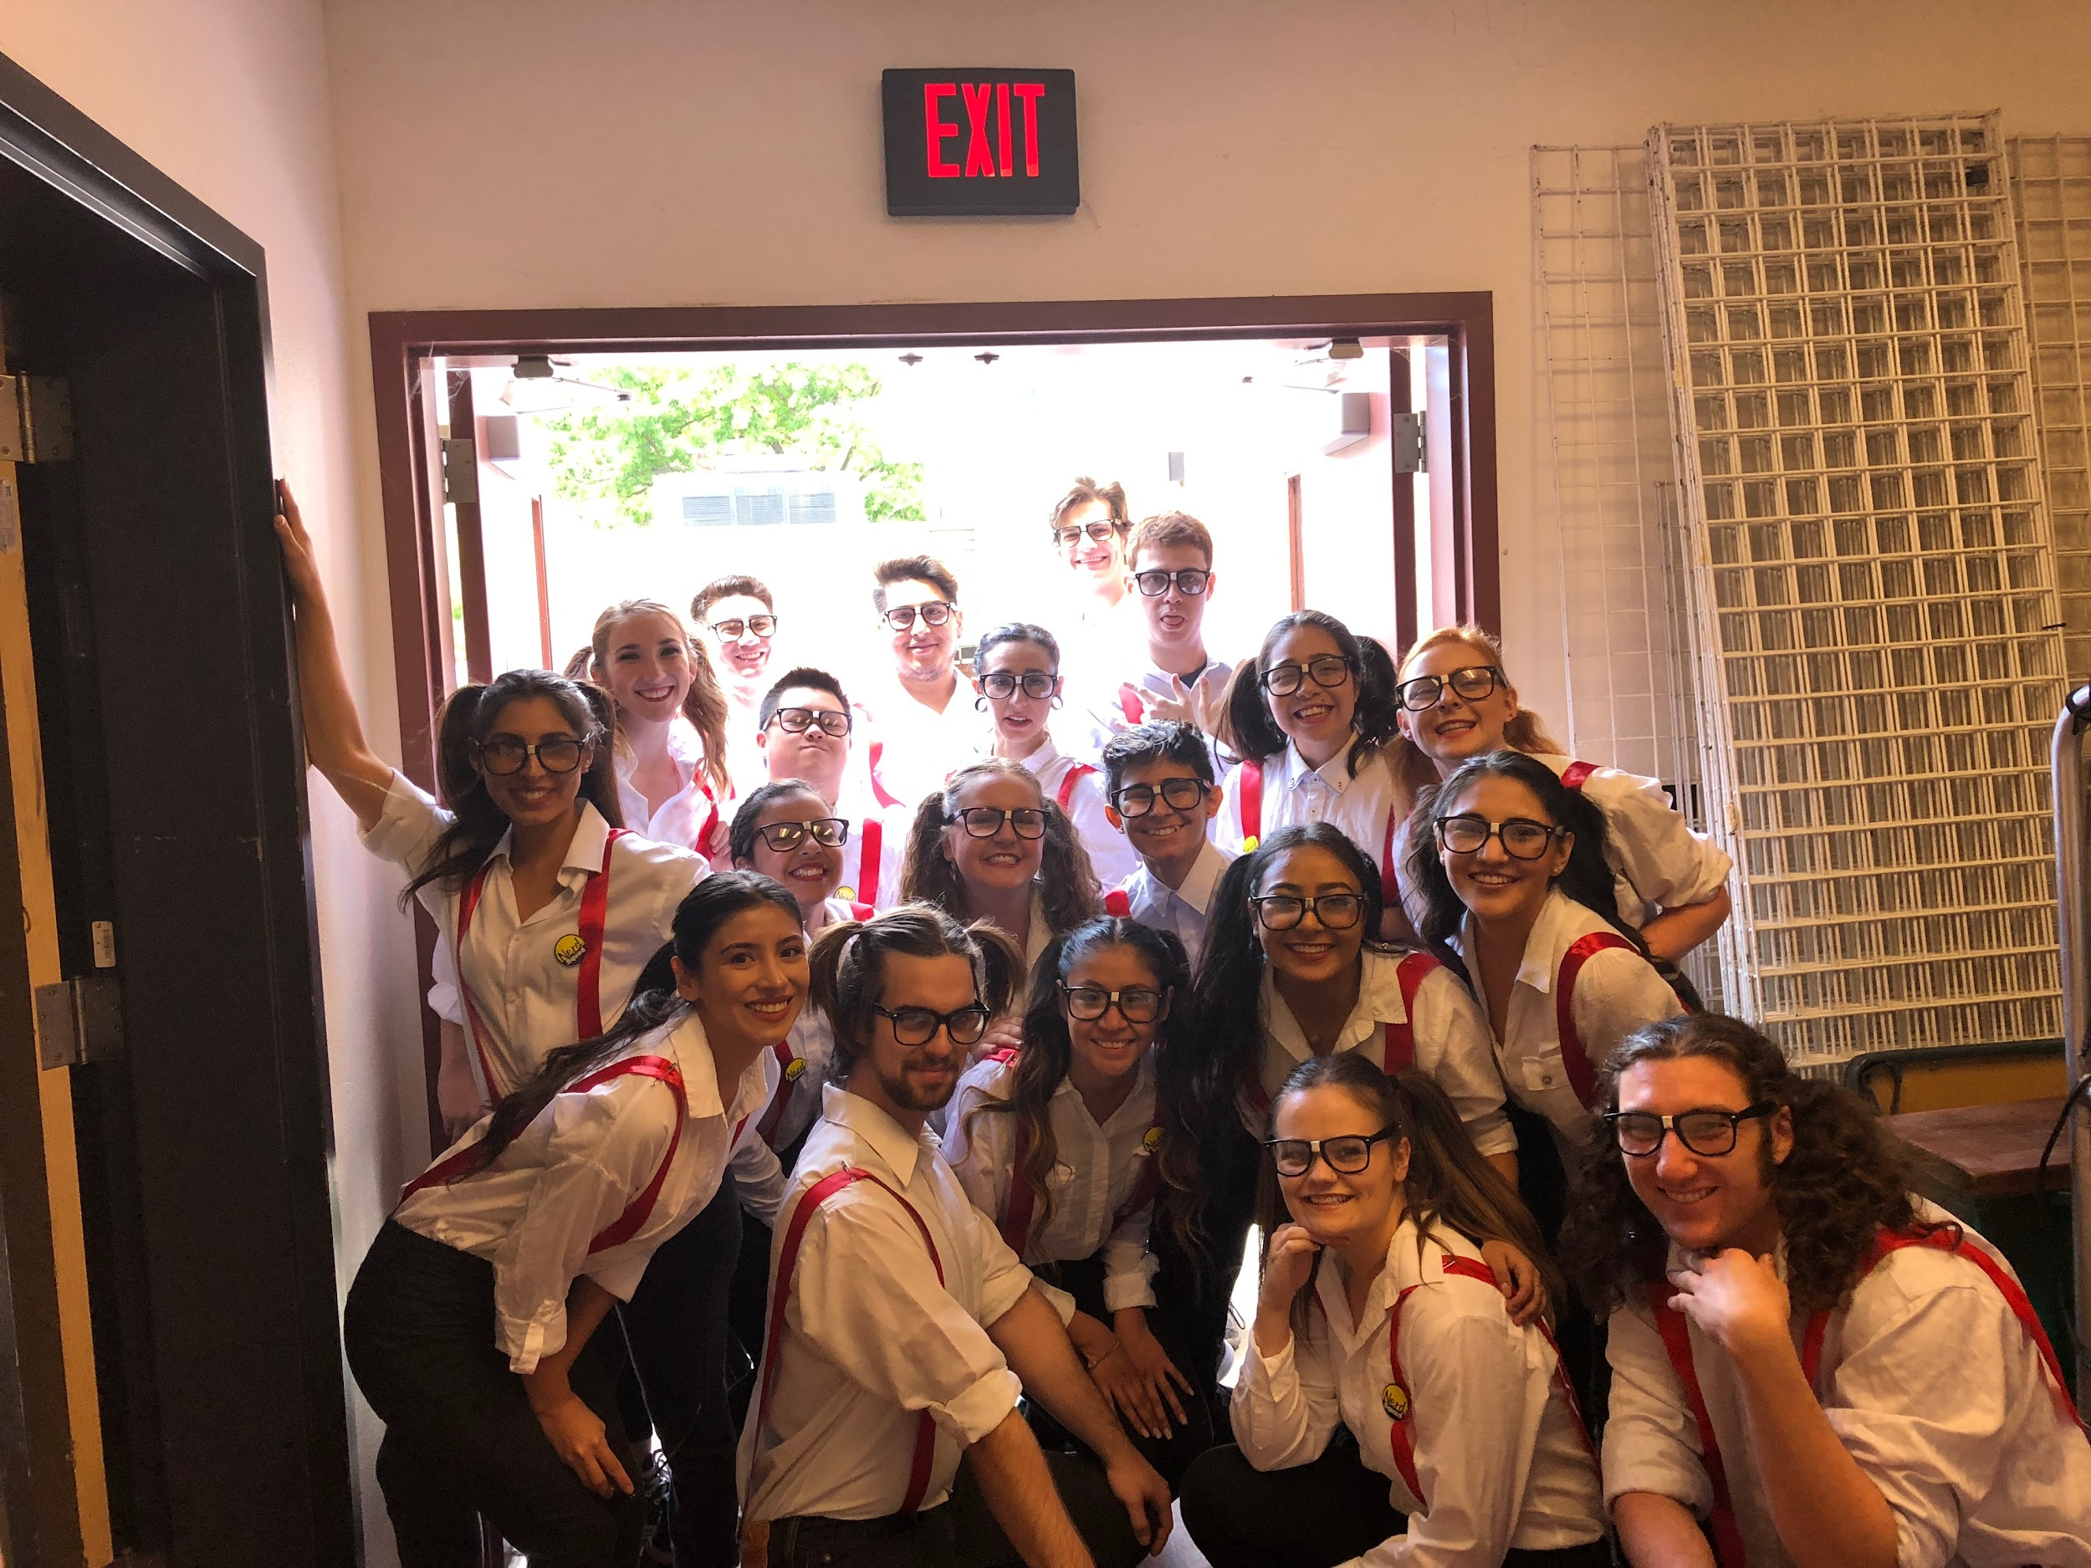

Slide 7

ENG130 PI Cycle One Makes Video

Slide 8
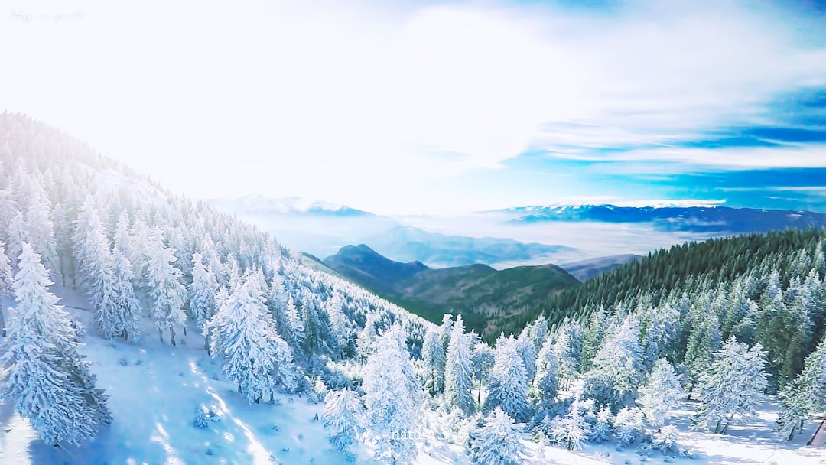
Don’t Judge A Person By
Where They Are,
Because You Don’t
Know How Far They’ve Come

